Slide 1
Assignment -3

Slide 2
Social Engineering
Social engineering is the term used for a broad range of malicious activities accomplished through human interactions. It uses psychological manipulation to trick users into making security mistakes or giving away sensitive information. Social engineering attacks happen in one or more steps. A perpetrator first investigates the intended victim to gather necessary background information, such as potential points of entry and weak security protocols, needed to proceed with the attack. Then, the attacker moves to gain the victim’s trust and provide stimuli for subsequent actions that break security practices, such as revealing sensitive information or granting access to critical resources.

Slide 3
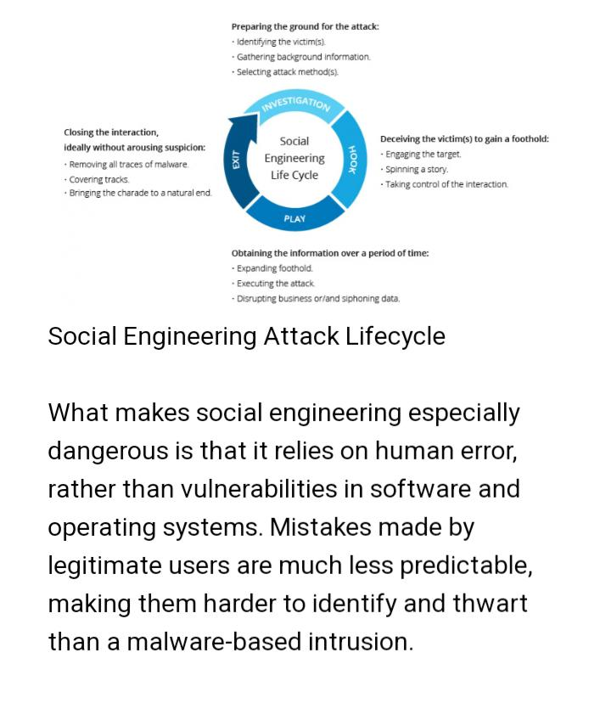

Slide 4
Social engineering attack techniques
Social engineering attacks come in many different forms and can be performed anywhere where human interaction is involved. The following are the five most common forms of digital social engineering assault.
1.Baiting: As its name implies, baiting attacks use a false promise to pique a victim’s greed or curiosity. They lure users into a trap that steals their personal information or inflicts their systems with malware
Victims pick up the bait out of curiosity and insert it into a work or home computer, resulting in automatic malware installation on the system.

Slide 5
2.Scareware: Scareware involves victims being bombarded with false alarms and fictitious threats. Users are deceived to think their system is infected with malware, prompting them to install software that has no real benefit (other than for the perpetrator) or is malware itself. Scareware is also referred to as deception software, rogue scanner software and fraudware.
Scareware is also distributed via spam email that doles out bogus warnings, or makes offers for users to buy worthless/harmful services.

Slide 6
3.pretexting: Here an attacker obtains information through a series of cleverly crafted lies. The scam is often initiated by a perpetrator pretending to need sensitive information from a victim so as to perform a critical task. The attacker usually starts by establishing trust with their victim by impersonating co-workers, police, bank and tax officials, or other persons who have right-to-know authority. The pretexter asks questions that are ostensibly required to confirm the victim’s identity, through which they gather important personal data.

Slide 7
5.Phishing:
As one of the most popular social engineering attack types, phishing scams are email and text message campaigns aimed at creating a sense of urgency, curiosity or fear in victims. It then prods them into revealing sensitive information, clicking on links to malicious websites, or opening attachments that contain malware. An example is an email sent to users of an online service that alerts them of a policy violation requiring immediate action on their part, such as a required password change. It includes a link to an illegitimate website—nearly identical in appearance to its legitimate version—prompting the unsuspecting user to enter their current credentials and new password. Upon form submittal the information is sent to the attacker.

Slide 8
6.Spear Phishing: This is a more targeted version of the phishing scam whereby an attacker chooses specific individuals or enterprises. They then tailor their messages based on characteristics, job positions, and contacts belonging to their victims to make their attack less conspicuous. Spear phishing requires much more effort on behalf of the perpetrator and may take weeks and months to pull off. They’re much harder to detect and have better success rates if done skillfully. A spear phishing scenario might involve an attacker who, in impersonating an organization’s IT consultant, sends an email to one or more employees. It’s worded and signed exactly as the consultant normally does, thereby deceiving recipients into thinking it’s an authentic message. The message prompts recipients to change their password and provides them with a link that redirects them to a malicious page where the attacker now captures their credentials

Slide 9
Cybersecurity Data Breach Incident Analysis Case Study: Redcliffe Labs Breach – A Technical Perspective on AI’s Potential
Analysis of the Event: Traditional security tools like email filters and anti-malware software failed to prevent the phishing attack and subsequent data exfiltration. An AI-powered email threat detection and analysis (ETDA) system could have analyzed email patterns and identified subtle abnormalities in phishing attempts, triggering alerts for investigation and preventing employee compromise. AI-powered email threat detection and analysis (ETDA) and user and entity behavior analytics (UEBA) solutions could have monitored user activity within the network and detected anomalous lateral movement indicative of unauthorized access and data exfiltration, enabling early containment and mitigation

Slide 10
Root cause: Lack of advanced email security measures capable of detecting sophisticated phishing and social engineering techniques. There is insufficient monitoring and analysis of user behavior within the network to identify malicious activity and data breaches.
Impact: Potential misuse of genetic data for discrimination, targeted scams, and personalized identity theft. Loss of trust in genetic testing services and erosion of patient privacy. Reputational damage for Redcliffe Labs and potential legal ramifications for data privacy violations.

Slide 11
Analysis and Explanation: The Redcliffe Labs breach highlights the limitations of traditional security tools against evolving cyber threats and the need for advanced AI-powered solutions to protect sensitive data, especially personal and genetic information. AI offers a powerful tool for proactive threat detection, anomaly identification, and automated incident response, addressing critical gaps in current security frameworks.

Slide 12
Impact and Value for Organizations: This case study illustrates the potential of AI to safeguard sensitive data, mitigate legal and reputational risks, and build trust with customers in data handling practices. For organizations handling sensitive information, investing in AI-powered security solutions can significantly enhance data protection, minimize breach costs, and protect brand reputation. Proactive detection and prevention of data breaches can save organizations substantial costs associated with investigation, remediation, and regulatory fines.

Slide 13
Analysis of Recommendations:
AI-powered email threat detection and analysis (ETDA) and user and entity behavior analytics (UEBA) solutions provide automated threat detection and anomaly identification capabilities, minimizing human error and response time. Data encryption and tokenization mitigate the impact of data breaches by rendering stolen information unusable. Cybersecurity awareness training empowers employees to identify and report suspicious activity, strengthening their overall security posture. Continuous vulnerability assessments and penetration testing ensure the proactive identification and patching of security weaknesses before they are exploited.

Slide 14
How can you train employees to follow authentication best practices? Powered by AI and the LinkedIn community 1.Why authentication matters 2.How to use strong passwords 3.How to enable multi-factor authentication 4.How to recognize phishing attempts
5.Here’s what else to consider

Slide 15
Authentication is a crucial part of cybersecurity, as it verifies the identity of users and prevents unauthorized access to sensitive data and systems. However, authentication is only effective if employees follow best practices and avoid common pitfalls that could compromise their credentials or expose them to phishing attacks. In this article, you will learn how to train your employees to follow authentication best practices, such as using strong passwords, enabling multi-factor authentication, and recognizing phishing attempts.

Slide 16
1.Why authentication matters Authentication is the process of verifying that a user is who they claim to be, and that they have the appropriate permissions to access a certain resource, such as a website, an email account, or a network. Authentication is essential for cybersecurity, as it protects data and systems from unauthorized access, tampering, or theft. Without authentication, anyone could impersonate a legitimate user and gain access to confidential information ,damage systems,or dispute operations
2How to use strong passwords Password authentication is one of the most common and basic forms of authentication, but it is also one of the most vulnerable and exploited. To protect your accounts, it is essential to train your employees to use strong passwords that are hard to guess or break. A combination of uppercase and lowercase letters, numbers, and symbols should be used, while personal information, common words, phrases, or patterns should be avoided. Additionally, different passwords should be used for different accounts and services, and passwords should be changed regularly to ensure security. A password manager can be used to store and generate passwords securely.

Slide 17
3.How to enable multi-factor authentication Another way to enhance authentication security is to use multi-factor authentication (MFA), which requires users to provide more than one piece of evidence to prove their identity. For example, in addition to entering a password, users may also have to enter a code sent to their phone or email, scan their fingerprint, or use a physical token. MFA adds an extra layer of protection against password breaches, as hackers would need to obtain more than one factor to access an account. Therefore, you should train your employees to enable and use MFA whenever possible, especially for high-risk or high-value accounts and services.
4.How to recognize phishing attempts Phishing is a type of cyberattack that involves sending fraudulent emails or messages that appear to come from legitimate sources, such as banks, government agencies, or colleagues. The goal of phishing is to trick users into clicking on malicious links, opening infected attachments, or providing sensitive information. It is one of the most common and effective ways of compromising authentication. To protect yourself and your organization against phishing attacks, you should train your employees to recognize and avoid them

Slide 18
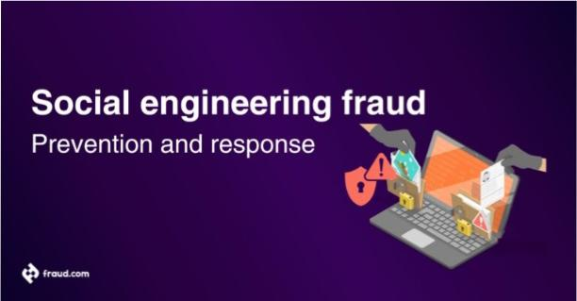

Slide 19
How does social engineering fraud work? Social engineering fraud manipulates the principle of trust through a sequence of deceptively simple steps intended to disorient, deceive, and ultimately defraud. Below, we encapsulate the key stages, incorporating the additional terms: Information gathering: Fraudsters initiate the process by spear phishing, meticulously studying targets to understand habits, relationships, interests, and daily schedules. This information is then used to construct a believable story, leveraging social engineering tactics to trick the victim.

Slide 20
Building trust or creating urgency: Depending on their strategy, fraudsters may invest time in building rapport or induce urgency by fabricating an emergency. Victims might receive messages that sound too good to be true, amplifying the deception through quid pro quo or other social engineering tactics. Exploitation: Once trust is established or panic instilled, fraudsters exploit it to gain access and trick users into revealing sensitive information. Social engineering techniques may involve playing on emotions, targeting social engineering, or using quid pro quo to manipulate human error.

Slide 21
Common tactics and techniques: 1. Phishing attacks: One of the most common forms of social engineering scams, phishing is a deceptive practice where a fraudster sends emails or messages disguised as a reputable entity, typically luring the individual into providing their financial information like bank credentials or credit card numbers. 2. Impersonation and identity theft: Banks, tax departments, tech support, and even standard email correspondences, can all be emulated by the fraudsters to fool the victims into taking harmful actions. This may include disclosing vital information or undertaking financial transactions under the impression they’re dealing with a person or company they trust. 3. Manipulation through social media: Social platforms are fertile grounds for gathering personal data. Fraudsters can create fake profiles, befriend potential victims, and exploit their trust to gain confidential information that can be used against them. 4. Pretexting and building false trust: Pretexting involves concocting a fake scenario to obtain personal information. It often involves impersonating someone in a position of authority or a person the victim trusts, to extract sensitive details.

Slide 22
Red flags to look for: 1. Unusual requests for information: It’s generally unusual for a trusted source to request sensitive personal information via email or a phone call. If this happens, it’s a clear sign of a potential scam. 2. Urgency and emotional appeals: Social engineers often trigger a sense of urgency or use emotional manipulation to rush the victim into action without giving them time to consider their actions. Be wary of any communication that demands immediate action. 3. Inconsistencies in communication: Check for grammatical errors, inconsistencies in logos or branding, or changes in the tone of written communication. An uncharacteristic email from your bank or an awkwardly worded instruction from an employer can be a clue that you are being targeted by a fraudster.

Slide 23
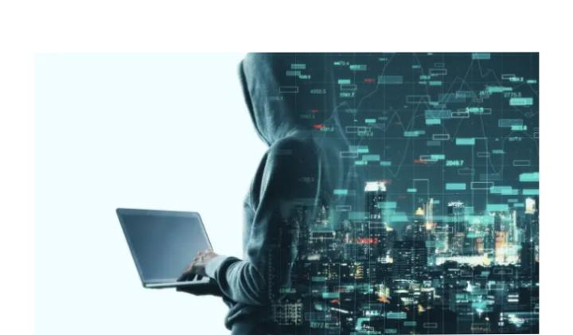
The 7 Red Flags of Phishing
Phishing is one of the most common threats you can encounter online. Luckily, phishing messages can be easy to spot – if you know what you’re looking for. Here are the seven biggest red flags you should check for when you receive an email or text:

Slide 24
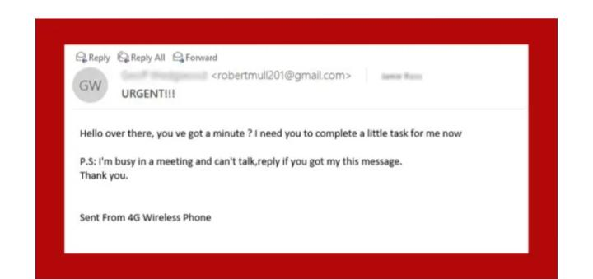
1. Urgent or Threatening Language: Real emergencies don’t happen over email. If something is truly a time-sensitive emergency someone will call. Look out for: Pressure to respond quickly Threats of closing your account or taking legal action

Slide 25
2. Requests for Sensitive Information Anyone asking for personal information over email or text probably shouldn’t be trusted with it, anyway. Look out for:
Links directing you to login pages Requests to update your account information Demands for your financial information, even from your bank.
3. Anything Too Good to be True
Winning a lottery is unlikely. Winning a lottery you didn’t enter is impossible Look out for: Winnings from contests you’ve never entered Prizes you have to pay to receive Inheritance from long-lost relatives

Slide 26
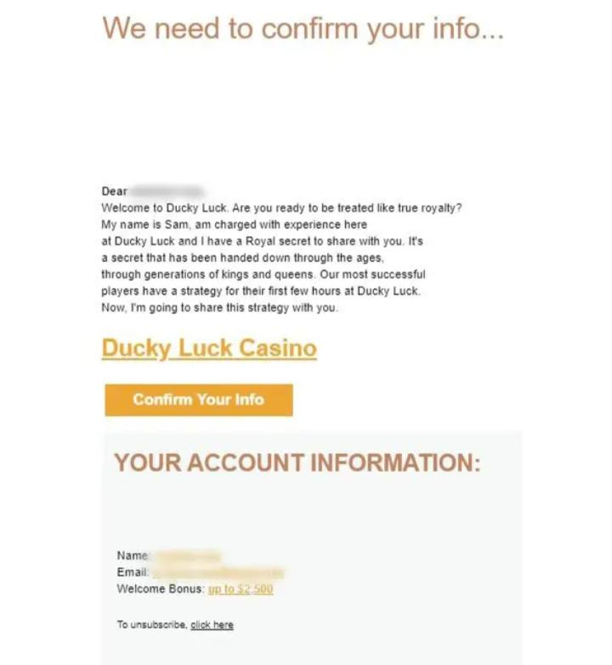

Slide 27
4. Unexpected Emails: Expect the unexpected, and then send it right to the trash. Look out for: Receipts for items you didn’t purchase Updates on deliveries for things you didn’t order
5. Information Mismatches: Searching for clues in phishing emails puts your love of true crime podcasts to good use. Look out for: Incorrect (but maybe similar) sender email addresses Links that don’t go to official websites Spelling or grammar errors, beyond the odd typo, that a legitimate organization wouldn’t miss

Slide 28
6. Suspicious Attachments Attachments might seem like gifts for your inbox. But just like real gifts, they’re not always good… Look out for: Attachments you didn’t ask for Weird file names Uncommon file types 7. Unprofessional Design: For some reason, hiring a graphic designer isn’t on a cybercriminals priority list. Look out for: Incorrect or blurry logos Company emails with little, poor, or no formatting Image-only emails (no highlightable text)

Slide 29
Phishing Attack Prevention: How to Identify & Avoid Phishing Scams
Internet pirates steal personal financial information with a new a type of Internet piracy called phishing, pronounced “fishing,” and that’s exactly what these thieves are doing: “fishing” for your personal financial information. What they want are account numbers, passwords, Social Security numbers, and other confidential information that they can use to loot your checking account or run up bills on your credit cards. In the worst case, you could find yourself a victim of identity theft. With the sensitive information obtained from a successful phishing scam, these thieves can take out loans or obtain credit cards and even driver’s licenses in your name. They can do damage to your financial history and personal reputation that can take years to unravel. But if you understand how phishing works and how to protect yourself, you can help stop this crime.

Slide 30
Here’s How Phishing Works: In a typical case, you’ll receive an email that appears to come from a reputable company that you recognize and do business with, such as your financial institution. In some cases, the email may appear to come from a government agency, including one of the federal financial institution regulatory agencies. The email will probably warn you of a serious problem that requires your immediate attention. It may use phrases, such as “Immediate attention required,” or “Please contact us immediately about your account.” The email will then encourage you to click on a button to go to the institution’s Website. In a phishing scam, you could be redirected to a phony Website that may look exactly like the real thing. Sometimes, in fact, it may be the company’s actual Website. In those cases, a pop-up window will quickly appear for the purpose of harvesting your financial information. In either case, you may be asked to update your account information or to provide information for verification purposes: your Social Security number, your account number, your password, or the information you use to verify your identity when speaking to a real financial institution, such as your mother’s maiden name or your place of birth.

Slide 31
How to Protect Yourself Never provide your personal information in response to an unsolicited request, whether it is over the phone or over the Internet. Emails and Internet pages created by phishers may look exactly like the real thing. They may even have a fake padlock icon that ordinarily is used to denote a secure site. If you did not initiate the communication, you should not provide any information. If you believe the contact may be legitimate, contact the financial institution yourself. You can find phone numbers and Websites on the monthly statements you receive from your financial institution, or you can look the company up in a phone book or on the Internet. The key is that you should be the one to initiate the contact, using contact information that you have verified yourself.

Slide 32
Never provide your password over the phone or in response to an unsolicited Internet request. A financial institution would never ask you to verify your account information online. Thieves armed with this information and your account number can help themselves to your savings. Review account statements regularly to ensure all charges are correct. If your account statement is late in arriving, call your financial institution to find out why. If your financial institution offers electronic account access, periodically review activity online to catch suspicious activity.

